Slide 1

UNDERSTANDING
Liane Stevenson @webdevelopwolf www.webdevelopwolf.com

Slide 2
INTRODUCTION
Let’s get on the road…

Slide 3
What did we do last time?
Finding out what Ionic is and does
Starting our first Ionic Mobile App
Looking at how navigation works in Ionic
Creating a skeleton app
How to work with Ionic Components

Slide 4
What are we doing in this section?
Finding out how to install SQL Server
Tools to manage your data
Database Fundamentals
How to query a database
Types of query
Prepping SQL Server to talk to our app

Slide 5
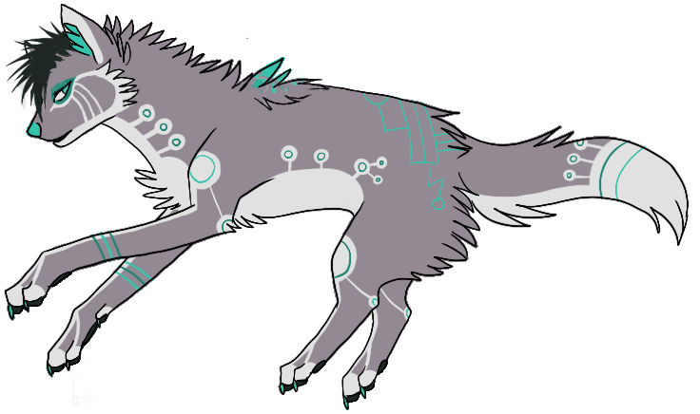
Need Help?
Github:
http://www.github.com/webdevelopwolf/training
Twitter:
http://www.twitter.com/webdevelopwolf
Facebook:
http://www.facebook.com/webdevwolf
Discord:
https://discord.gg/jWGvtnZ

Slide 6
WHAT IS SQL?
I need this too???

Slide 7
What does SQL even stand for?
SQL is short for Structured Query Language
And lets you connect with & shape your collected data

Slide 8
What can SQL do?
SQL Can…
Read
Write
Update
Delete
Create databases
Create tables
Create stored procedures
Create views
Manage Permissions

Slide 9
Why do we need SQL?
Remember our dynamic data?
Data that changes according to context
We need somewhere to store it all
We do this using SQL Server
SQL queries SQL Server
Whereas SQL server keeps data safe & secure
SQL will help us to manage, test & maintain that data

Slide 10
Another Small Disclaimer…
SQL is a massive topic covering decades of theory and experimentation
We are going to keep what we learn about SQL as relevant to our app as possible
To learn more, the best place to start is Google and to experiment yourself

